Slide 2

Integrated University Department Information System
Team A6

Slide 3
The Software
Integrated University Department Information System
Solution to a Disembodied University
Aggregate Department’s Finances using a Tallying System
Conducts Minute Operations that interconnects Department to the larger University System
Notes:
Ajay - Death by PPTX

Slide 4
The Team
NYU SOE CS-UY-4513 Team A6
Project Manager/Advisor
Professor Fred Strauss
Majors: Computer Science, BS
Munieshwar “Kevin” Ramdass
Programmer, Author, Reviewer
Coordinator
Ajay Shenoy
Programmer, Author, Reviewer
August Tan
Programmer, Author, Reviewer
Notes:
All - Death by PPTX

Slide 5
Overview
Software Overview
Requirements
Team Organization
Risk Analysis
Classes
Architecture
Summary (PIR)
Expectations for Spring 2015
Notes:
Ajay - Death by PPTX

Slide 6
Software Overview
Interaction
The Budget System
The Database system for the Computer Science department
Large University System
Regulation
Student Records
Laboratory Administration
The Ordering of Goods & Services
The Management of Account Receivable & Payable
Actors and Resources
Students
Professors
Officials
Administrator
Third Party goods/service providers
Department Database
Notes:
Ajay - The Integrated University Departmental Information System is a smaller part of the larger university system that will interact with the budget system and the database system for the computer science department.
Our expected user base is comprise of university administrators, who will have complete access, and professors and students who will have limited access to the system , and a permissible amount of
consulting done by Third Party goods and service providers.
We expect that Officials such as advisors to be able to handle regulations such as the ones listed.

Slide 7
Requirements
1. Administrators/Officials must be able to create/modify/delete/view class.
2. Administrators/Officials must be able to create/modify/delete/view any user account.
3. There must be a way to update a student’s transcript and disclose them to the appropriate student.
4. Officials from university system must be able to handle all expenses.
5. There must be a payable and receivable system.
6. The use of the integrated university’s emailing and mailing system will be used.
7. Administrators must have access to entire IUDIS and its database.
8. There must be a way for users to login and logout.
Notes:
Kevin - read 3, 5 and 4 Definitions (in that exact order)

Slide 8
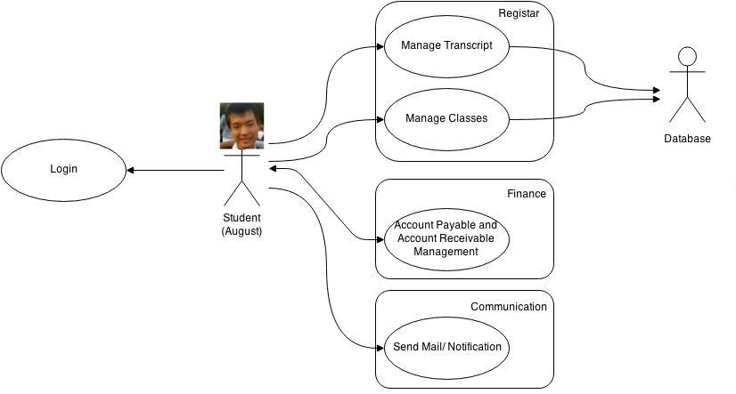
Requirements
Student
Notes:
Lets say August, a student, is attempting to access his transcript, first the IUDIS would prompt him to login, from there various options would be displayed to him via the “Manage Transcript” use case.
There will be sub use cases here like the “View Transcript” use case.

Slide 9
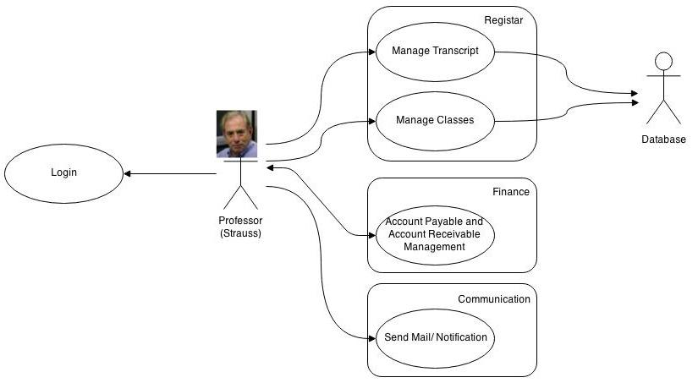
Requirements
Professor
Notes:
Here we have a professor (Strauss) and he would like to "enter grades" for his students, he could use the “Manage Transcript” use case.
There will be sub use cases here "enter grades" sub use case.

Slide 10
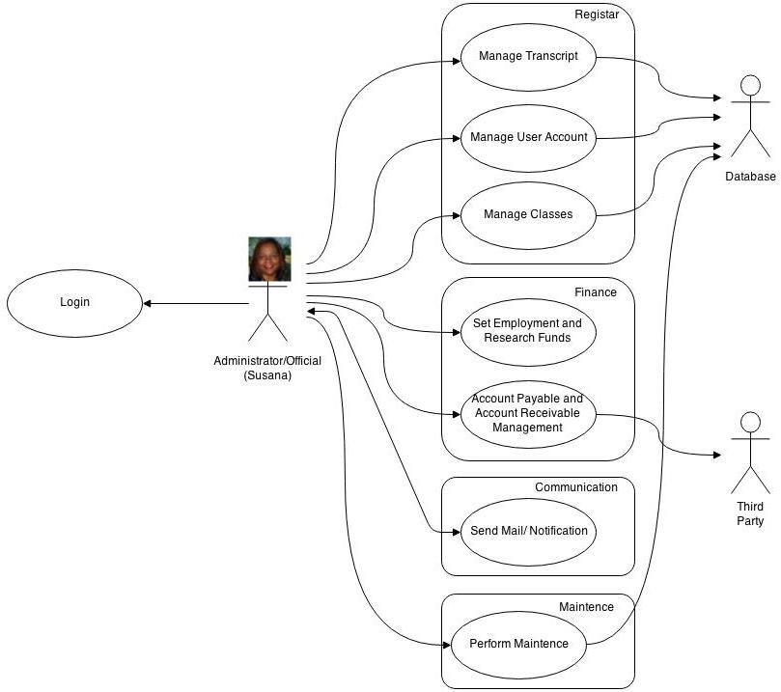
Requirements
Admin/Official
Notes:
and Finally we have the Susie G's part, who would like to pay the third party consultants, she would need to use the Account payable use case
There will be sub use cases here "Pay third party bill"

Slide 11
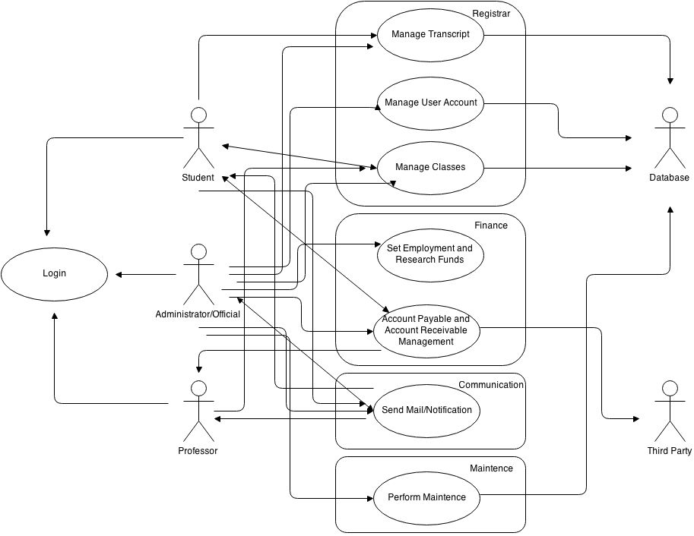
Requirements
The Entire
Used Case
Diagram
Notes:
Kevin - Here’s the larger used case diagram with each actor included. This one is hard to trace, thus the reason why we split them to small diagrams.

Slide 12
Team Organization
- Democratic Team (3 Members)
Rotating Partnerships
- Process
Unified Process (recent change)
Incremental
Notes:
Kevin - We are a team of 3. Rotating partnerships have one coordinator while the other two members are working together on a task. For the next task, there will be a new coordinator and new partnership.
Therefore, everyone has a chance to be the coordinator. We are after all a democratic team. We like the idea of documenting our process since we have lots of use cases to keep track.
We would like the freedom of changing the requirements as much as needed.

Slide 13
Risk Analysis
Risk | Probability | Responsible Person | Mitigation | Status
Late Submission | 25% | Munieshwar Ramdass | Request extension from Advisor for deliverable | Ongoing
Product not built to Specifications | 15% | Ajay Shenoy, August Tan | Check all requirements and specifications | Ongoing
Illness of a Member | 20% | Partner of the ill | Use the Agile Process. Another member can take up the sick member’s work. | Ongoing
Illness of Partnership | 4% | Remaining Members | Other members must be informed on the work of the ill | Ongoing
Member fails/drops Course and Project | 1% | Remaining Members | Terminate project or get one more person to make a team of 3 | Ongoing
Notes:
August – Death by PPTX

Slide 14
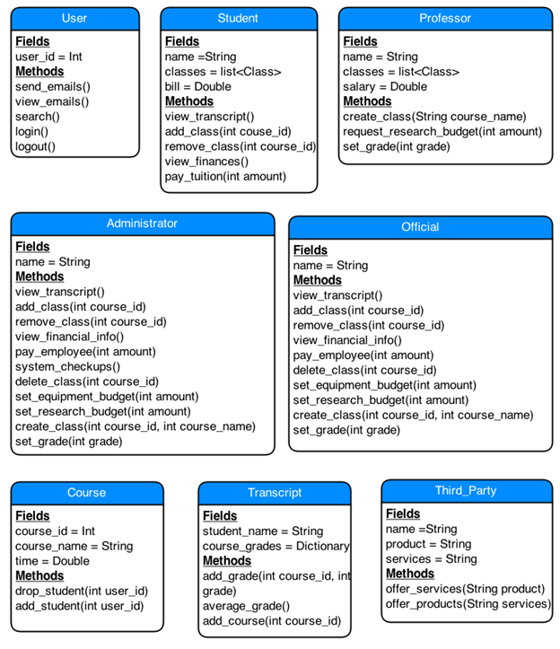
Classes
Actors
Notes:
Here are a list of methods that we have contrived for each user

Slide 15
Classes
Others

Slide 16
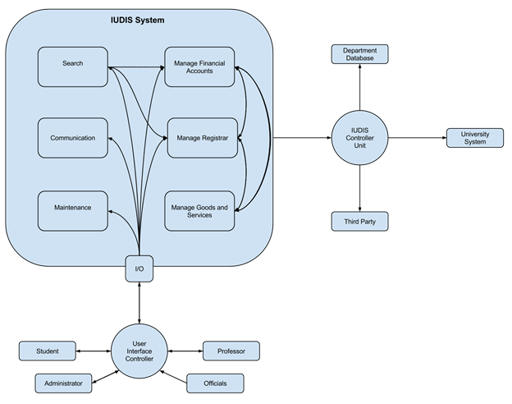
Architecture
Component
Architecture
Diagram
Notes:
The architecture of the IUDIS is as follows, August the student form earlier will interact with the user interface controller, which will prompt him to access his set methods through the I/O, and if needs be updating
the university’s database via the IUDIS control unit.

Slide 17
Summary: Things Done Right
Time Management
All deliverables done on Time
Avoid Risks
None of our Risks Occurred so far
Architecture
Rest of our Project depend on Architecture
Notes:
August – Death by PPTX

Slide 18
Summary: Things Done Wrong
We hardly have Meetings
Reason why Members may not be on the same Page
There may be more Classes
There might be Classes that act as “Wrappers”
Use Cases are Vague
Correction may Result in ~20 Sub-Use Cases
Notes:
August - Death by PPTX - Kevin - There will be wrapper classes such as the Registrar class and Financial class; those sound like good nouns.

Slide 19
Summary: Changes
Process recently changed to Unified Process
Unified Process allows for Requirement Changes
Introduce more Time for Reviews
Reduce Defects
Revamp the Use Cases
Add Sub-Use Cases
Notes:
August – Death by PPTX

Slide 20
Expectations: Spring 2015
Learn Databases
Part of Training as Specified in our SPMP
Start Implementation Soon
As Specified in our Microsoft Project Diagram
Leave Lots of Time for Walkthroughs/Inspections
Time to be Certain our Software fits Specifications
Notes:
August - Death by PPTX

Slide 21
Expectations: Spring 2015
Gantt Chart
Notes:
Ajay - According to our pre-planned assessment of the project we are currently on schedule.

Slide 22
Questions?
Notes:
August – Shot down by questions.

Slide 23
Integrated University Department Information System
Team A6

